Slide 1
Team 3
Gary Johns
Dan Lain
Jose Flores

Slide 2
Vision
Create a cutting edge innovative project management software tool to allow small to medium sized companies to keep track of ongoing projects, employees, and costs. This tool shall allow the company to produce Gantt Charts, resource tracking, cost reports, and velocity tracking. This system will be developed by a small agile team consisting of three hard working code monkeys, fueled by caffeine and B-12.

Slide 3
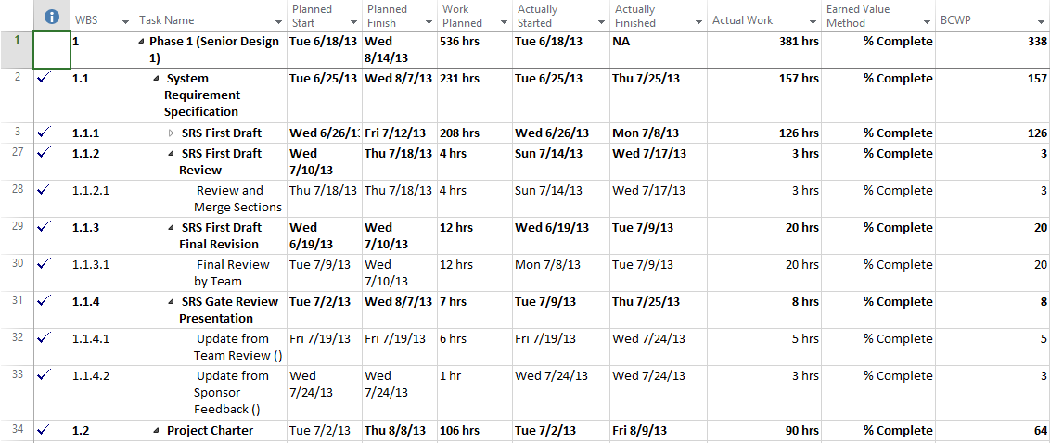
Concept

Slide 4
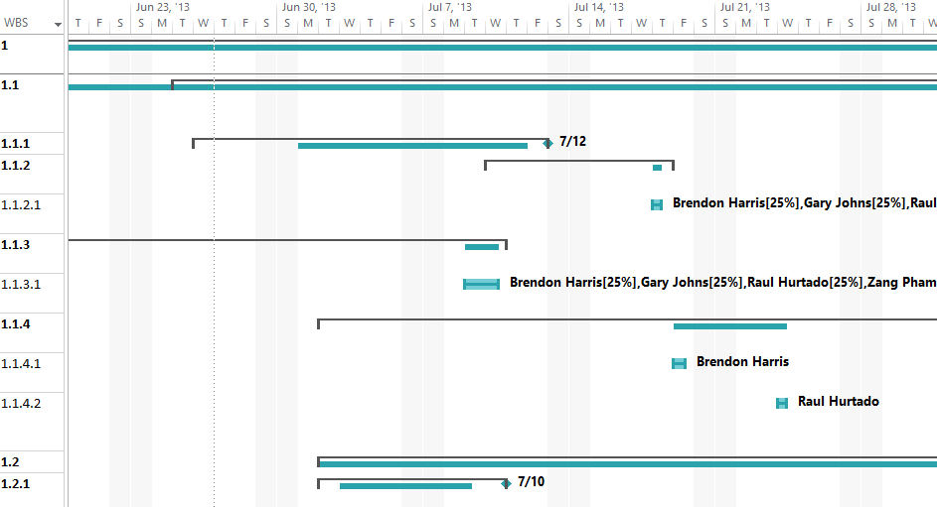
Concept continued

Slide 5
Competetors
Microsoft Project
Green Hoper
Excel
Agilefant
VersionOne

Slide 6
Features
Gantt Charts
Multiple projects
Tracking
Cost
Hours
Velocity (Sprint Management)
Employees
Aggregate Reporting across multiple projects

Slide 7
Risks
Complicated Charting
Small Team
Limited Time
Many competing projects
Limited experience with technology stack

